Slide 1

Ten Myths of ICT4D
Kentaro Toyama
Visiting Scholar
University of California, Berkeley
Presented at Summer School on Computing for Socio-Economic Development
Microsoft Research India / Indian Institute of Science – June 23, 2010

Slide 2
“Kids in the developing world need the newest technology…”
“Can the cellphone help
end global poverty?”
“The Internet
should be a human right in and of itself.”
Sources: New York Times, 2008; Best, M. L., 2004; Negroponte, N. 2005.
Notes:
We were not the only ones, and worldwide, there is a growing movement to apply information technologies to international socio-economic development. Unfortunately, like a lot of movements, there’s a tendency for rhetoric and ideology to take over.
As you can see from these real quotations from prominent academics and journalists, the rhetoric suggests that it’s absolutely urgent that we spread novel technologies, as a way to address the challenges of poverty.
<number>

Slide 3
Myths of ICT4D

Slide 4
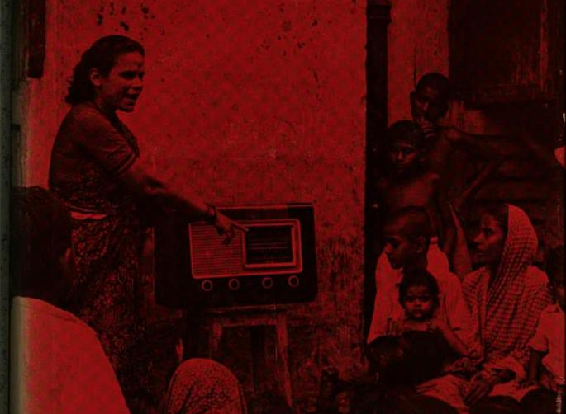
“… X has never been used to its full capacity in support of economic development. It may be financially impossible to use it in this way. But still the possibility is tantalizing: What is the full power and vividness of X teaching were to be used to help the schools develop a country’s new educational pattern? What if the full persuasive and instructional power of X were to be used in support of community development and the modernization of farming? Where would the break-even point come? Where would the saving in rate of change catch up with the increased cost?”
X = “television”
Source: Schramm, Wilbur. (1964) Mass Media and National Development:
The Role of Information in the Developing Countries. Pp. 231
Notes:
In the 1960s, people used to believe that TV could provide universal education.
<number>

Slide 5

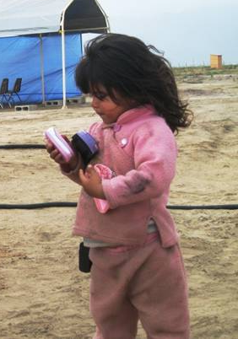
Myth 1
Wasn’t true for X = radio, TV, or landline phone, despite initial expectations and significant penetration.
Doesn’t seem true for X = PC.
How about X = mobile phone?
There are still poor communities with no phones.
Many poor villages have only a few phones.
Ownership ≠ usage
Usage ≠ sophisticated usage
Sophisticated usage ≠ increase in welfare
Photo credit: Tom Pirelli

Slide 6
Given your current financial status,* would you pay 20% of your income on an ongoing basis for any of the following…?
Customized news
Premium banking services
Tutoring services
Better health plan
(*) Or, use your expected financial status as a working adult, if you’re a student.
Notes:
People earning <$200,000 would probably not pay $50,000 a year for any one of these things, because most of us have working alternatives that cost us much less.
<number>

Slide 7

Myth 2
Costs of goods and services in peri-urban Bangalore.
PC/Internet capability | Existing Alternative | Cost (US$ per hour)
Search for information | Social networks | Free
Health information | Government health clinic | Free
Agriculture information | Government agricultural extension | Free
Accounting | Notebook and calculator | 0.01
Data exchange | Bicycle (local 10 kms, few hours) | 0.10
Entertainment | Movie in a theatre | 0.10
Music | CD player + buying pirated CDs (MP3) | 0.12
News | TV + cable | 0.12
Education | Private school in Bangalore | 0.12
PC/internet access | 1 hour in an Internet café | 0.25
<number>
Source: Aishwarya Ratan & Kentaro Toyama
Notes:
<number>

Slide 8
If you had 20% of your annual income to spare right now, and had to spend it on one of the following, which would you spend it on…?
A part-time personal assistant
Travel and tourism
iPhone or other gadget
(*) Or, use your expected financial status as a working adult, if you’re a student.
Notes:
Forced-choice question. Again, most people who earn <$200K would probably spend it on (a) or (b). Bill Gates, on the other hand, might perceive (c) as a real need, whereas the others are “frivolous” desires. With his frame of reference, it might seem odd that “poor” people like us would choose to spend on desires over “needs.”
<number>

Slide 9

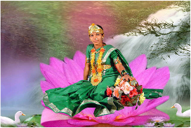
Myth 3
“Needs” are relative. Bill Gates needs his personal assistants and might think we relatively poor people to be foolish to spend on travel or gadgets and other “frivolous” expenses.
“Needs assessments” typically reveal the same needs, though no one spends on them…
Better healthcare
Better education
Better income opportunities
Etc.
The same populations often spend lavishly on…
Ring tones
Music and movies
Weddings and funerals
Customized photos
Etc.
Photo Credit: Udai Singh Pawar
Sources: Udai Singh Pawar, Nimmi Rangaswamy, Thomas Smyth, Etc.

Slide 10
In which of the following businesses does Google make a profit…?
Search
YouTube
Google Maps
Sources: http://www.internetevolution.com/author.asp?section_id=715&doc_id=175123&
http://mashable.com/2007/12/17/800-goog-411-free-but-not-profitable/
Notes:
Google makes almost all of its profit from search. The others lose money, at least as of 2009. YouTube, which many Internet users see as indispensible, is still not breaking even, and search via voice is also not able to make money. Moral of the story: Not everything that is fantastic or fantastically useful is easy to convert into a business.
<number>

Slide 11

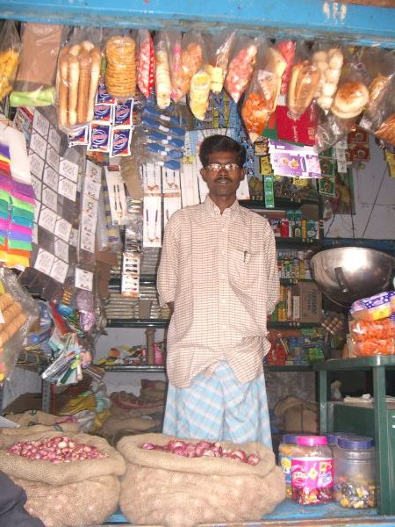
Myth 4
People don’t always pay for “needs.”
E.g., children’s education
E.g., water purifiers
E.g., health insurance
“Poverty premium” exists for a reason. Poor populations are…
Harder to reach
A greater risk
Poor! (Less disposable income)
Someone has to pay.
The poor are poor.
Their governments are poor.
Their donors are limited.
Even ads are ultimately paid for by customers, who in this case, are poor.
Notes:
<number>

Slide 12
Do you consistently…?
Exercise
Avoid unhealthy foods
Wear a seatbelt
Start assignments early enough to do a good job
Notes:
Most of us know that these are all good for us, yet the reality is that we don’t do them. Getting the auto industry to include seatbelts by default, then mandating that people wear seatbelts, and then getting people to actually wear seatbelts took several decades of hard lobbying, campaigning, and public-awareness advertising.
<number>

Slide 13

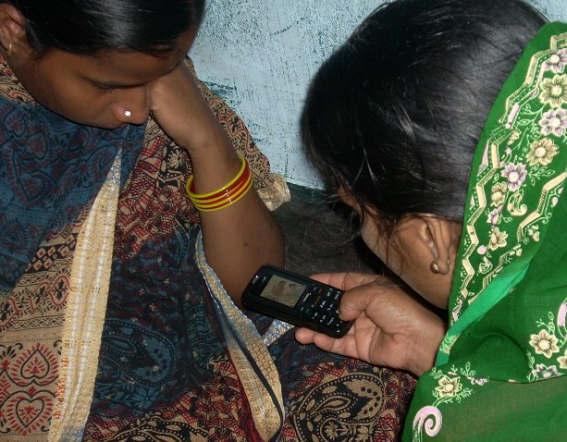
Myth 5
People don’t do what’s “best” for them.
Spend today versus save for tomorrow
Children’s education versus extra labor in field
10% of curable blind don’t go to have surgery, even when cost-free.
Many people don’t wear seatbelts or stop smoking, although they understand the implications.
Photo Credit: Divya Ramachandran

Slide 14
You and a poor rural farmer are each given a single e-mail account and asked to raise as much money for the charity of your choice.
Who would be able to raise more money?
Notes:
The technology in both instances is exactly the same, yet because of your superior education, social network, e-mail writing ability, etc., you will be able to raise many times more money than a poor farmer in a rural village.
<number>

Slide 15

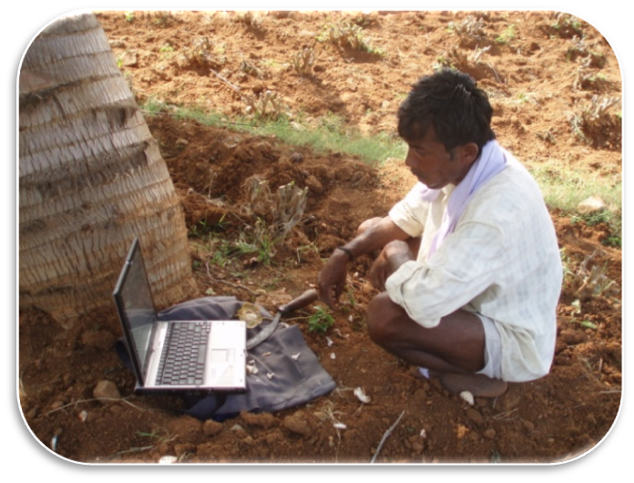
Myth 6
Or, “the Internet democratizes…”
Or, “the world is flat (because of technology)”
Technology is multiplicative, not additive (e.g., Tichenor et al., 1970)
Photo credit: Rikin Gandhi
Reference: Tichenor, P.J., Donohue, G.A., & Olien, C.N. (1970).
Mass media and the differential growth in knowledge.
Public Opinion Quarterly, 34, 158-70.

Slide 16
Which of the following will have the most impact on making you fitter…?
Buying a treadmill
Self-imposed exercise regimen
Hiring a physical trainer
Notes:
Most people I’ve asked answer (c), some answer (b); I’ve so far never heard (a). Everyone knows that the hard part is actually doing the work necessary to accomplish a goal, not providing the technology.
<number>

Slide 17

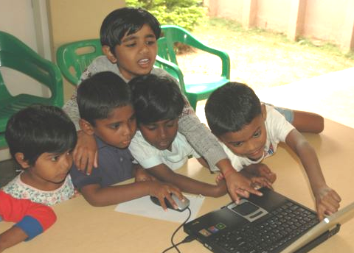
Myth 7
Some things do leapfrog:
Upper class capacity
E.g., recent Indian upper class
“Adopted” poor children
E.g., Shanti Bhavan
New technology over old technology
E.g., broadband over dial-up
E.g., mobile phone over landline phone
But…
Human capacity develops slowly
Role of technology in education is poorly understood.
Owning an treadmill doesn’t make you fitter in itself.
Education and human capacity are the critical things.
Photo Credit: Divya Ramachandran

Slide 18
How much does a typical US corporation spend on its IT budget per user per year…?
$70
$700
$7000
$70000
Source: Computer Economics (2009) IT Spending and Staffing Benchmarks 2009/2010.
http://www.computereconomics.com/page.cfm?name=IT%20Spending%20and%20Staffing%20Study
Notes:
Note that this is at least several times more than the cost of a good PC, per year.
<number>

Slide 19

Myth 8
Conservative, back-of-the-envelope calculations for actual costs per child per year, for a “$100 PC” per child, amortized over 5 years.
Hardware/software (replaced every 5 years) $20 $100 / 5 years
Distribution, installation, power stability $25 Low estimate
“Losses” in distribution $20 Conservatively, 20%
Breakage, theft, unintended sale $20 e.g., 1 in 5 each year
Connectivity and power $15 Low estimate
System administration, maintenance $100 = $10,000/yr / 100 kids
Teacher training $50 Maine laptop project cites 1/3 total cost for teacher training
---------------------------------------------------------------------------------------------------------------------
Total $250 per child, per year cost
$1250 per child, every five years
Notes:
<number>

Slide 20
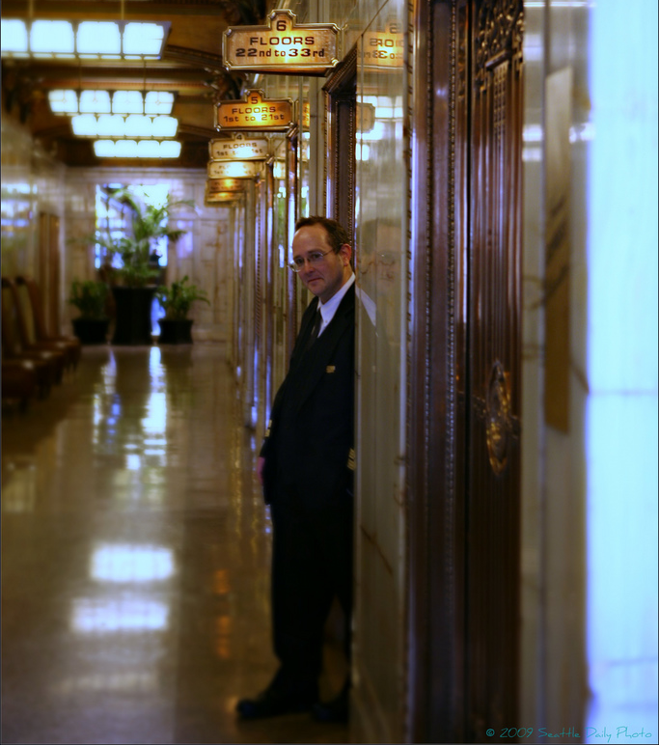
What is this man’s job?
Which of the following will have the most impact on making you fitter…?
Buying a treadmill
Self-imposed exercise regimen
Hiring a physical trainer
Photo credit: http://seattle-daily-photo.blogspot.com/2009/04/elevator-operator.html
Notes:
Elevator attendants were a common phenomenon in most countries, prior to push-button elevators, and high costs of labor. Developing countries are still in that era, because labor costs are so low.
<number>

Slide 21

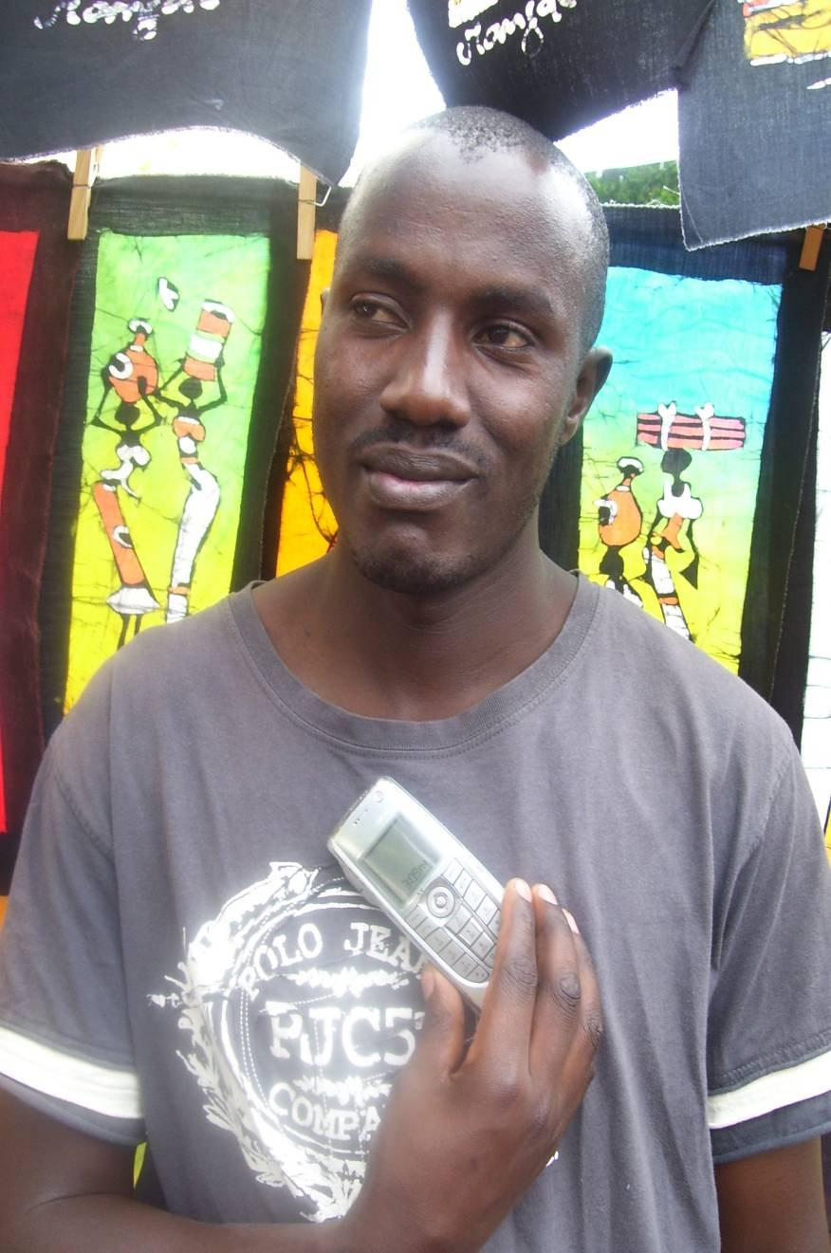
Myth 9
Issues with full automation:
Barriers of literacy, cost, unfamiliarity, etc.
User preferences for voice and human-mediated systems
Accuracy of data collection better through call centers?
Cost of human system < cost of technology?
Photo Credit: Shikoh Gitau, Jonathan Donner
Sources: A. Ratan, M. Gogineni, Cost Realism in Deploying Technologies for Development, Oxford 2008.
I. Medhi, N. Gautama, K. Toyama. A Comparison of Mobile Money-Transfer Uis. CHI 2009.
S. Patnaik, E. Brunskill, and W. Thies. Evaluating the Accuracy of Data Collection on Mobile Phones: A Study of Forms, SMS, and Voice. ICTD2009.

Slide 22


Are you as rich as you’d like to be?
Are you as educated as you’d like to be?
Are you as compassionate as you’d like to be?
Sources: http://www.google.com/search?q=how+to+be+rich
http://ocw.mit.edu
http://zenhabits.net/2007/06/a-guide-to-cultivating-compassion-in-your-life-with-7-practices/
Notes:
The information for how to be wealthy, educated, or compassionate is all out there, available to every one of us who has Internet access. Yet, most of us are not as rich, educated, or compassionate as we’d like to be. Why not?
<number>

Slide 23

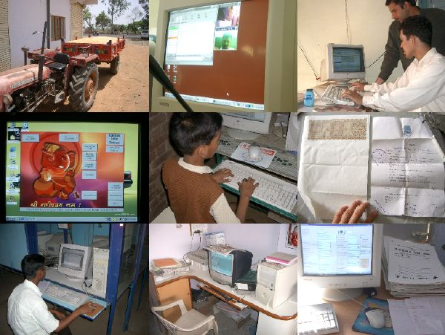
Myth 10
Information is just one of many deficiencies in developing world.
Other deficiencies:
human capacity
economics
infrastructure
institutional capacity
political clout
etc.
Information ≠ education
Communication ≠ commerce

Slide 24
Conclusion

Slide 25
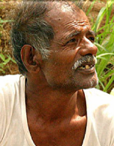

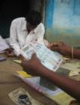
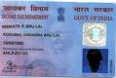
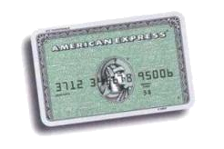
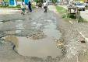
Agricultural Systems?
farmer
expert
Low literacy in local lang
No bank account
Expensive credit
No unique ID
Credit card
Poor roads
Market
Volume
buyers
Poor quality
control
Device and connectivity not enough!
Notes:
<number>

Slide 26
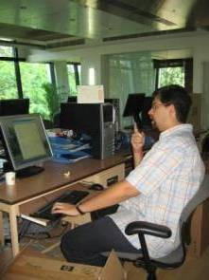

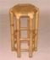
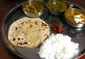

E-commerce?
seller
buyer
Low literacy in local lang
No bank account
Expensive credit
No unique ID
Credit card
Poor roads
Parcel service
ongoing
business
opportunity
Small scale production/ quality diff
HH consumption pressures
Device and connectivity not enough!
Ill health
Notes:
<number>

Slide 27

Rural Telemedicine?
patient
doctor
Low literacy in local lang
No bank account
Expensive credit
No unique ID
Credit card
Poor roads
Poor access to drugs
Medicine
Device and connectivity not enough!
Trust absent
without healthworker
Notes:
<number>

Slide 28



Rural Telemedicine with new device?
patient
doctor
Low literacy in local lang
No bank account
Expensive credit
No unique ID
Credit card
Poor roads
Poor access to drugs
Medicine
Device and connectivity not enough?
Trust absent
without healthworker
Notes:
<number>

Slide 29
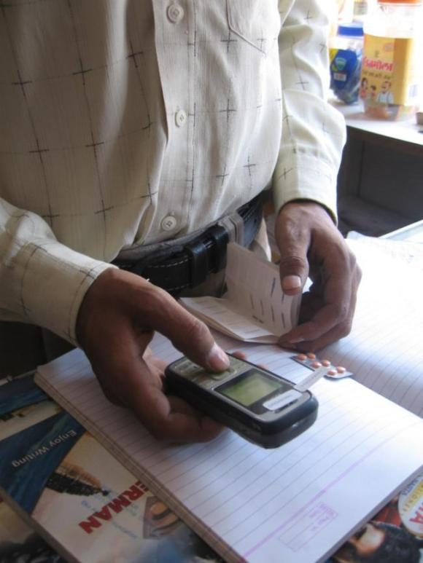
Successes Exist
PCs for NGO / MFI back ends
Unsung success
Grameen Village Phone
Mobile killer app: voice!
M-PESA
Money transfer ($160M in first year)
Same-language subtitling for literacy
Better literacy for 200M+ people
Long-distance WiFi for eye care
Enabled 50,000+ consultations
Etc.
Photo Credit: Indrani Medhi

Slide 30

Technology is Just One Part
Physical
building,
goods,
transport,
roads
Human
education,
computer literacy,
motivation,
awareness
Social
institutions,
norms,
political support
Financial
operational costs,
maintenance,
training
Digital
hardware,
software,
connectivity,
content

Slide 31
In the Developed World…
(includes wealthier segments of developing countries)
Digital
hardware,
software,
connectivity,
content
Physical
building,
goods,
transport,
roads
Human
education,
computer literacy,
motivation,
awareness
Social
institutions,
norms,
political support
Financial
operational costs,
maintenance,
training

Slide 32
In the Developing World…
Digital
hardware,
software,
connectivity,
content

Slide 33
Technology magnifies human intent and capability.
Technology itself requires support from well-intentioned, competent people or organizations.
Successful ICT4D interventions work as a part of well-intentioned, competent organizations.

Slide 34
“Kids in the developing world need the newest technology…”
“Can the cellphone help
end global poverty?”
“The Internet
should be a human right in and of itself.”
Sources: New York Times, 2008; Best, M. L., 2004; Negroponte, 2005.
Notes:
We were not the only ones, and worldwide, there is a growing movement to apply information technologies to international socio-economic development. Unfortunately, like a lot of movements, there’s a tendency for rhetoric and ideology to take over.
As you can see from these real quotations from prominent academics and journalists, the rhetoric suggests that it’s absolutely urgent that we spread novel technologies, as a way to address the challenges of poverty.
<number>

Slide 35
“Twitter is changing the way we live.”
“The Internet democratizes access to information.”
“Social networking will transform learning”
“Each of us is simultaneously an individual person and a global publisher.”
“The Internet changes everything.”
Sources: Time Magazine, Nonprofit Technology Conference, The Huffington Post, Wall Street Journal, Cybermedia.
Notes:
Here are quotes about online technology in the developed world. “Social networking will transform learning.” “Twitter is changing the way we live.” With daily news like this, it’s no wonder that we think technology can save the earth.
<number>

Slide 36
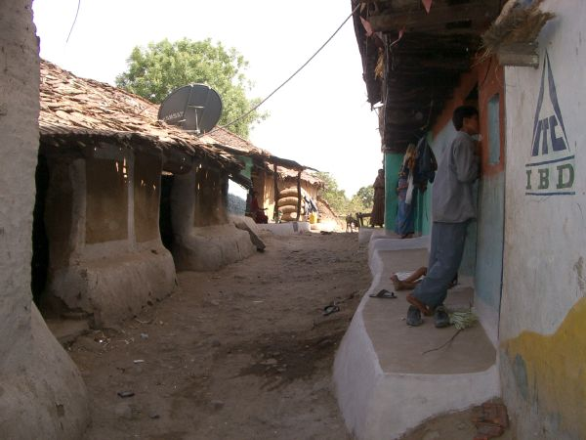
Why do these myths persist?
Desire for an easy solution
Desire for a one-time, catalytic investment
Desire to see ingenuity triumph
Seductive power of technology in the developed world
Not enough insight into actual poor communities
Misleading explanations of successful ICT4D projects – a variation of AI’s “frame problem”

Slide 37

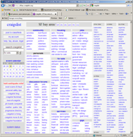

Internet
Internet
Notes:
There are many reasons, but the one I’ll discuss now is something I call the “myth of scale,” and here is a simplified version of how it fools us: Imagine a person like you and me. She’s bored of her job and wants a job change. So, she uses the Internet and, after a few searches and some interviews, she lands a job. She then says, “The Internet got me a job!”
We take this at face value and apply it to a poor person, maybe doing backbreaking menial labor. We think, “if only she had access to the Internet, she could perhaps study on her own and find herself a job, too!” When we realize there are lots of poor people out there, we then suggest that we can scale the solution by giving everyone access to the Internet. They could then all find better jobs and lead better lives. Unfortunately, things never work out this way, and it’s because we’ve misattributed cause.
<number>

Slide 38





Notes:
What really happens is this. Here’s again a person like us. Invisible, but very powerful, are all of these advantages – good education, some foundation of wealth, ability to navigate formal organizations, ability to negotiate complex social systems. With the Internet, sure, it might be easier for us to find a job.
But, these advantages don’t necessarily exist for everyone else. Here’s a person without our advantages. The Internet, alas, doesn’t do anything – it certainly won’t help her get through her interviews.
And, if you really think about it, we actually never needed the Internet to get a job in the first place – people like us can get good jobs even without technology.
<number>

Slide 39
Notes:
So, what do we do, those of us who are technologists and entrepreneurs and who want to do something good for society? Well, some of you have heard the saying, “If you give people a fish, they eat for a day; if you teach them to fish, they eat for a lifetime.” No one ever said you should build them a heat-seeking turbo-charged robotic fishing rod! Technology is often believed to be a shortcut to large-scale impact, but there is no shortcut to changing people. And, it’s change in people that matters. Instead of trying to save the world with technology, I think the most meaningful thing that people like us can do is to teach and to mentor, so that we can share the advantages we’re lucky to have with others.
<number>

Slide 40
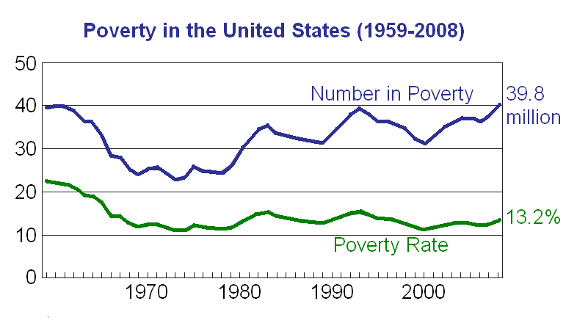
ARPANET
Google
Cellphone
Microsoft
iPhone
WWW
PC
Sources: U.S. Census Bureau, Wikipedia
Notes:
Well, let’s put these claims to the test. Consider poverty again, but this time, not in the developing world, but rather in the United States of America, the source of so much computing innovation and arguably the most technologically advanced country in the world.
This is a graph of the number in poverty and the percentage who are poor in the United States over the last half century. As you can see, poverty declined until about 1970, but since then, the percentage of people under the poverty line has not budged, and absolute numbers of the poor have only increased. Since 1970, here’s what happened…
The Internet was born, cellphones were invented, and major technology companies pushed their products into every home and onto every desktop. If technology were the answer to the deep problems of society, things should have gotten better with better technology, but they haven’t. Why not? Why doesn’t technology solve societal problems, and why do we keep thinking that it will?
<number>

Slide 41
Summary
Myths of ICT4D
Technology X will save the world.
Poor people have no alternatives.
Needs are more pressing than desires.
Needs translate to business models.
If you build it, they will come.
ICT undoes “rich getting richer.”
Technology permits socio-economic leapfrogging.
Hardware and software are a one-time cost.
Automated is cheaper and better.
Information is the bottleneck.
Key Lesson
Technology is a magnifier of human will, competence, and institutions.

Slide 42
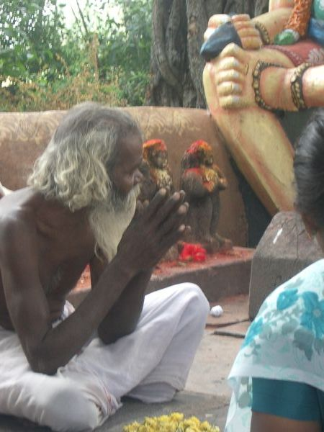
Thanks!
kentaro_toyama@hotmail.com http://www.kentarotoyama.org

